Slide 1
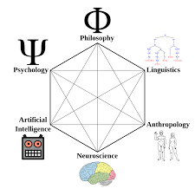

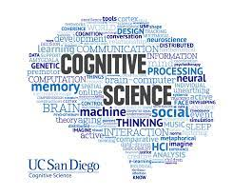
COG 250 Tutorial 3
TA: Konstantinos Xanthios
Oct. 17, 2025
TUT0102, TUT0202, TUT0302
RW142

Slide 2
Outline
Midterm Test 1 Format
Concept Review
Group Activity: Practice Questions

Slide 3
Test Tips
Remember to elaborate on how the concept in question is relevant to the course content.
The Relevance section is worth twice as many points- please keep this in mind when you’re writing your answers. Try and draw from as much of the course context as you can
  Aim for a solid 3-4 sentences on this
For example: if the concept is Dualism- you can talk about how dualism presents the mind body problem. The division between mental and physical becomes relevant for how we study the different frameworks of cognitive science
Please try on novel connections and criticisms, even if you are stuck and can’t think of anything! We will not deduct points on this.
Aim for a solid 2 sentences for each.
For Dualism:
  Criticism: This distinction between mental and physical (or mind and body) simply doesn’t hold up for our contemporary understanding of the mind (you can draw from lecture 5 and minimal minds to make this point)
  Connection: this distinction between mental and physical was taken up in computational functionalism and its influence from linguistics (syntax, semantics)- remember to elaborate more on these points
The interlude lecture (lecture 5) and it’s emphasis on minimal minds, is a great source for exploring novel connections
Advice from Mark’s lecture: Excellent answers
how many ideas can you successfully bring together- quality is also important
Need comprehensive answer- test for comprehension- grappling with main concepts of the course

Slide 4
Midterm 1: October 22 2025
Midterm 1: Oct. 22, 2025. Worth 10% of your grade
Same location as our lecture, during the same lecture time (3 hours).
You will be provided with a list of 10 concepts. You are responsible for choosing 6 of these and providing:
  Definition (2 points): Briefly define the concept in question
  Relevance (4 points): Explanation of its Relevance to the course
  Criticism of the concept (2 points: this could be taken from Mark’s lectures).
    OR: You could use the concept in question to criticize something else.
  Novel Connection (2 points): Connecting the chosen concept to another idea in the course. For example, if the concept is “Dualism”, you could choose to talk about it’s relation to one of the approaches to Cognitive Science discussed in class (Computational Functionalism, Connectionism, etc.)
Aim to provide this information in approximately 200 words for each concept, although you can use as much space as is necessary
Please note: The point values here were taken from last year’s Midterm 1, where each concept was worth 10 points, with the test being out of 60.

Slide 5
Minimal Minds and Biological Plausibility
Recall from last time: Connectionism was found to be more biologically plausible than Computational Functionalism:
In modelling it’s account of cognition after how our brains work (as opposed to how language works), connectionism is closer to realizing Strong AI despite its shortcomings
Our interlude lecture explored more on this idea of biological plausibility for certain cognitive systems.
This lead us to discuss Minimal minds: the goal is to establish the minimal conditions that must be satisfied for an entity to have cognitive states or carry out cognitive processes.
Through Huebner’s work on minimal minds, we were able to see distributed representations happening in bee communication, similar to what we’ve seen in distributed patterns of activation in connectionism.

Slide 6
Huebner and Bees: 4 Characteristics of Minimal Minds
Huebner suggests that suggest that the possession of a minimal mind requires 4 characteristics:
1. An organism must possess internal states and processes that have the function of adjusting the entity’s behavior in ways that allow it to cope with features of its environment in ways that are not fully determined by the design of the system;
  Bees: are capable of adjusting behaviour based on external factors- weather conditions . They Use internal processes to adjust states, decision making is influenced by past events. Bees satisfy first requirement!
2. These states and processes must be capable of standing-in for various features of the environment that are significant for the system, and they must be capable of doing so even in the absence of immediate environmental stimuli;
  Bees: Do these states stand in? Yes, bee waggles, encodes information- direct distance quality, allows bee to understand info for food- wiggles back in hive to communicate, holds a distributed representation decoded by the hive
  Dancing becomes a representation that stands in for information in the world
3. These states and processes must be part of a larger representational scheme that allows for a variety of possible contents to be represented (in a systematic way) by a corresponding variety of possible representations;
  Bees: Waggle dance is systematic- system of parts, angle of dance relative to hive displays food source. This is a system of ideas that hang together, use variety of representations, allows bees to convey many information sources
4. There must be norms governing the proper production, maintenance, and use of these representations under various environmental conditions.
  Bees: Waggle dance becomes interpreted in certain ways- crucial for effectiveness of dance, precise wiggle=more accurate info, adjust dance with respect to position of sun and wind Bees are able to update internal maps subject to environmental conditions

Slide 7
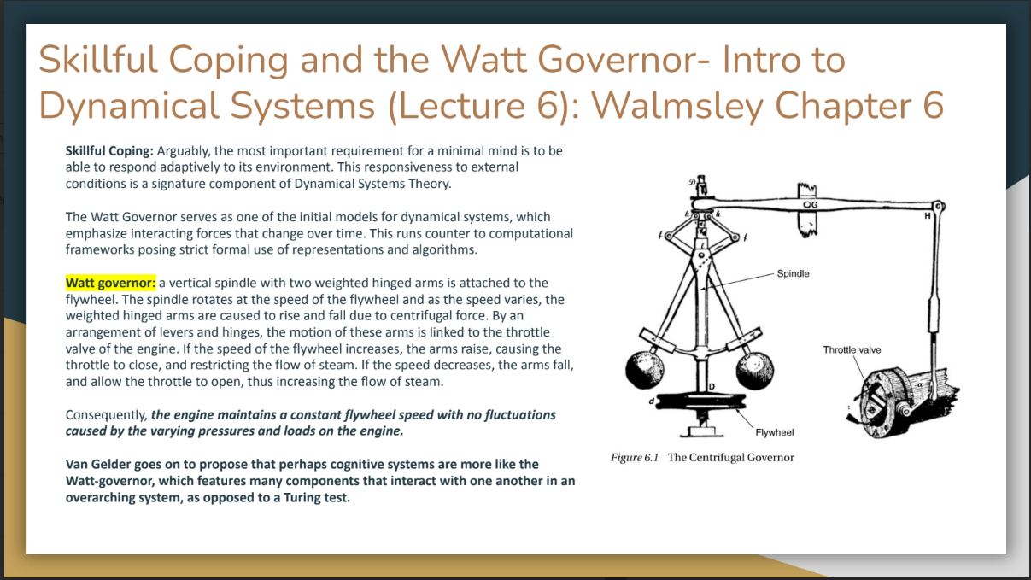

Slide 8
Midterm Practice: Group Activity 1
The following activity will be completed in 2 groups.
For each group, choose 5 concepts from this slide deck and please provide the following for each:
A definition of the concept
Explain its relevance to the course content
Provide a criticism of the concept
Provide a novel connection for that concept
Group 1: Concepts 1-5
Group 2: Concepts 6-10
To answer this, you can use your notes from class, the lecture slides, or my slides from our previous tutorials.
We will spend about 20 minutes for this activity, then return to share our answers with the group. It would be a good idea for you guys to take notes and supplement your answers with other’s responses!
I will post a link to a google doc for you all to complete this activity:
Tutorial 1: https://docs.google.com/document/d/116LXLCgdE1mgWusP-l42yozlXvXfGzXQFwjkiNlaQTs/edit?tab=t.0
Tutorial 2: https://docs.google.com/document/d/1HxRUOxxhTXIi5ap3wB_aBGAH7xYF6pCA46wBOOOp6k4/edit?tab=t.0
Tutorial 3: https://docs.google.com/document/d/1jOZTYqY2YLxDOfaBLhrp1sWRiVPjtArqQisjE_2TxZg/edit?tab=t.0
I will also provide my slides from our previous tutorials in the rest of this slide deck (slides 5-7, and 10-29).

Slide 9
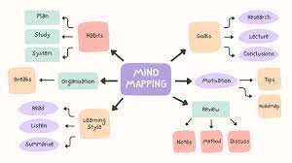
Midterm Practice: Group Activity 2- How to Make Connections?
You can train your ability to make connections by doing the following:
Collaborating with Other Students: Form study groups, get to know one another and practice taking each other's perspectives
Recognise Before Recall: Try testing your ability to recall the argument of the course, using the concepts presented in lecture.
Synthesize: Explore how different ideas combine together- can this make your argument stronger?
Diagram: Visualise the relationships between concepts using a mind-map
Activity: Using the document from the last activity, try sketching out a mind map of possible connections (like in the diagram below) between the concepts that you’ve identified.
For each connection, try and elaborate on why the relationship is important for understanding cognitive science
Also try and elaborate on how this connection can help us understand the concepts better

Slide 10
Lecture 1 Review: How to do Cognitive Science
There are several different disciplines which attempt to explain the mind at different levels of analysis. The role of cognitive science is to determine the relationship between these different levels and disciplines that study the mind:
Level: Culture and distributed cognition—Discipline: Anthropology
Level: Language and language structure or processing—Discipline: Linguistics
Level: Behavior–Discipline: Psychology
Level: Information processing and machine simulations—Discipline: Computer Science
Level: Brain-imaging and neurophysiology—Discipline: Neuroscience
The role of Philosophy: It makes a conceptual unity of these disciplines and tries to provide bridging constructs/common conceptual terms between them.
Cognitive Science is thus a discipline that studies the mind in terms of the interaction between all these other disciplines. This makes the role of the cognitive scientist much like the philosopher in terms of their eye for cross-discipline interactions.
Synthetic Philosophy: aims at developing new frameworks. “Synthetic philosophy” is a style of philosophy that brings together insights from the special sciences in order to develop new theoretical frameworks for thinking about those special sciences and topics in philosophy (Schliesser 2019).
In so doing, cognitive science aims to achieve an interdisciplinary study of the mind, in an attempt to discover how these levels of examining cognition relate to one another and thus provide a fuller, more synthesized account of what cognition is.

Slide 11
Lecture 1: Problems posed by Cognitive Science
The problem of Equivocation: Equivocation involves an inherent ambiguity in any explanation. It occurs when we have two different systems that are using the same language, but in entirely different ways.
Consider the term: “Information”
  in genetics, information is “encoded”- how those particles in gene are internalized
  Physics- the term information pertains to changes in the entropy of the system
As we will see, the term “Computation” is also subject to equivocation in different fields.
The Siloing problem of the specialized sciences
  Siloing: a special science pays only attention to what an individual system is doing, instead of paying attention to the actions of its neighboring sciences
In both cases, an interdisciplinary approach that synthesizes disciplines together is well-equipped to provide the conceptual clarity necessary for examining cognition across different levels of analysis.

Slide 12
Lecture 2 Review: What is a Mind?
Scientific Revolution: period of rapid mathematical and technological advancement, leading to discoveries of inertial motion: objects in the universe aren’t moving with a sense of purpose. Their behaviour follows a series of mathematical laws (as studied by physics).
Rene Descartes: argues that what we need in order to know the world and derive certainty is to make our mind a mathematical, a logical machine.
Material Substances: can be mathematically measured, calculated, predicted and manipulated.
  Primary properties: are actually “real” properties in the world, exist in objects. These mathematical properties are objective properties that exist in the world.
Mental Substances: non-mathematical, subjective and exist in our minds as part of our experience, but not in the world. They were said to be illusory as they only exist as a subject of our experience.
  Encompass secondary properties: “Qualia” and exist as part of our conscious experience
This leads to the proposal of Cartesian Dualism: The mind is constitutive of mental substances, the body of material. This gives rise to the Mind-Body Problem

Slide 13
Lecture 2: Hobbes Proposal and Descartes’ Response
Thomas Hobbes: grapples with these new advancements happening during this time, and proposes the view that cognition is computation.
In Hobbes’ proposal, the mind is tantamount to a material computer, with matter that automatically follows a series of logical manipulations according to a set of rules. For Hobbes, this notion of computation is what it means for a mind to be cognitive.
Hobbes saw this computing machine as a way of explaining how we can engage in our capacities for reason (ratiocination), as a means of doing science.
Descartes: Responds to Hobbes
If one is doing science, they must be capable of reasoning- which involves acting on purpose to get to the goal of truth as a normative standard and as a way of improving oneself.
One can’t tell is something is true, and move towards it on purpose, unless one knows what that truth means.
Thus, Truth is actually a function of meaning, which has to do with Qualia- aspects of the subjectivity of our conscious experience
These secondary properties can’t be measured mathematically , even though they are crucial to engage in scientific reasoning

Slide 14
Paradox of Mechanical Reasoning, Problem of Original Meaning
Hobbes responds by suggesting intentionality: mental things point to, are directed at, and have content about something other than themselves. This intentionality is part of what makes mental things meaningful.
However, Descartes notes that Hobbes is now equivocating and is making a mistake. The concepts represented with intentionality are understood by Hobbes as purely physical things. Descartes is pointing out two things to Hobbes, which are related:
The Paradox of mechanical reasoning: if a process is operating purely mechanically, then it is not operating on purpose with a goal of getting closer to the truth. It’s not concerned with the meaning and qualia of our experience.
  Therefore, If this process is purely mechanical, then it can’t possibly be reasoning!
At the heart of this is the problem of original meaning: Matter (or material processes), according to Descartes, cannot possibly possess meaning in and of themselves. They can only have derived meaning by being systematically associated with purely mental states that have meaning.
  This is the case because, according to the scientific revolution, mental properties (qualia) only exist subjectively in our mind. Matter (or mechanical processes), by definition, exist objectively

Slide 15
Section 3- The Point: The Project of AI
With Hobbes’ statement that cognition is computation, he proposes the project of artificial intelligence during the advent of the scientific revolution
This proposal of artificial intelligence and the generation of the scientific worldview are deeply interwoven and interdependent.
That’s why the project- or what Haugeland calls “the very idea”- of artificial intelligence has a philosophical depth to it, and is not simply about making machines.

Slide 16
2 Contemporary Perspectives on AI: Walmsley Chapter 1 (Week 2 Reading)
Perspective 1: Newel and Simon: who explicitly regard computers and programs as experiments -
“constructing the machine poses a question to nature; and we listen for the answer by observing the machine in operation” (1976, p.114).
In this case, AI is an empirical science: We often have to rely on observation of what the computer does, much as if we were observing the participant in a conventional psychology experiment. Iterations are made to the program to more accurately capture the behaviour we’re looking for
Perspective 2: André Kukla (1989a) : Argues that AI is not an empirical science, but rather is – like mathematics – an a priori enterprise
Contrasts work in AI with experiments in psychology. Goal in psychology is to come up with a theory about the underlying structure that generates the observed behaviour. But when we run a program on a computer, we already know the underlying structure; it’s the program, and we wrote it!
The relation between a computer’s program and its behaviour is a logical one (akin to the relation between the premises and the conclusion of a deductive argument). So running a program is equivalent to constructing a logical proof.

Slide 17
First Generation Cognitive Science: Computational Functionalism
Computational Functionalism: Encompasses the computational theory of mind, or the view that cognition is computation. Functionalism takes inspiration from Linguistics, where cognition follows a rule-like structure, making it fundamentally language-like
Within the context of this course, computational functionalism encompasses Good-Old Fashioned Artificial Intelligence (GOFAI).
Functionalism was a movement away from behaviourism, which unsuccessfully tried to study cognition solely based on observable behaviour conditioned from associations between stimulus and response.
The failure to properly consider the role of mental states lead to the proposal that what is important to study cognition is the function of the cognitive processing, as opposed to only the observable behaviours.
These developments lead to the study of computers as symbol-crunching machines: These are considered to be interpretive, automatic formal Systems as a means of explaining cognition.
We will touch on GOFAI very briefly today, leading up to the problems with computational functionalism and moving onto connectionism

Slide 18
GOFAI: Computational Theory of Mind
Functionalism centred on viewing the mind as a Computer: An interpreted automatic formal system, which involves three aspects central to GOFAI (Haugeland). This is heavily inspired by the Linguistic theorist Chomsky, outlining cognition as logically following the rules of language structure (syntax):
Symbol manipulation: Formal systems can manipulate symbols in a way that is governed by syntactic rules.
From this we can get multiple realizability:
  by making the system realizable across many physical media, as long as the symbols are manipulated according to those same sets of rules.
  This means that the same states can be realized in different processes- humans and machines may experience the same states (i.e. language and logic) in spite of different physical components (meat vs. circuitry)
Digitality: It has a set of positive and reliable techniques for reading and writing symbols within the system
Finite playability: A finite system is capable of following rules in a mindless, mechanical manner.
Automaticity: A formal system is considered to be automatic if its complex computational processes can be broken down into primitive algorithms composed of primitive operations and primitive rules, such that it can run and follow those rules on its own.
This is responsible for the self-containedness of formal systems, and in so doing forms the basis of GOFAI and the computational theory of mind

Slide 19
Chapter 3- The Turing Test: Example of GOFAI
Alan Turing: demonstrated that machines can be set up to perform symbol crunching to solve any well defined problem. Did this by reducing the syntax down to a symbol set, for the machine to churn out a solution following a set of rules (much like a formal system)
Turing’s developments eventually gave way to the idea of an “imitation game” for trying to find an instance of human intelligence. This was later referred to as the “Turing Test”:
The set-up is this: Two systems have a conversation with one another- one is a human, and the other a computer.
A judge/interrogator attempts to work out, solely by means of written questions and answers, which of two other conversants is a human and which is a computer/machine.
If the judge were to mistake the machine’s performance to be that of a human’s, then the machine were said to have passed the test.

Slide 20
Chapter 3- Searle, Chinese Room Argument
Using Turing’s set-up, Searle positioned a thought experiment that proved to be a powerful counter-argument against the prevailing view of computational functionalism. This was the Chinese Room Argument:
“Imagine a man – let’s call him John –who knows no Chinese, but is locked in a room in which there are a number of boxes of Chinese symbols. John’s only contact with the outside world is via a mail slot through which slips of paper can be passed. In the room there is also a scratch-pad for rough work, and a large book, in English, which contains a great number of rules that tell John how to match certain sequences of Chinese characters with other sequences of Chinese characters. The rule- book says things like ‘If such-and-such characters come in through the mail slot, wait a short while and then push so-and-so characters out of the mail slot.’ John might not even know that the symbols are Chinese, but this doesn’t matter, because he can work by simply matching the shape of the characters in the inbox to the shape of those depicted in the rule book.
Unbeknownst to John, there are native Chinese speakers outside of the room, and they are the ones passing the strings of symbols into the room and retrieving the strings of symbols that John sends out. They call these symbol strings ‘questions’ and ‘answers’. Finally, suppose that the rules are so sophisticated, and that John is so good at following them, that the native Chinese speakers are not able to distinguish the ‘answers’ they get from John-in-the-room from those that would be given by another native Chinese speaker. John-in-the-room passes the Turing Test in Chinese”

Slide 21
Chapter 3-Searle: Chinese Room Argument
The question now becomes: even though John passed the Turing test, is he capable of actually understanding Chinese?
Searle: The answer to this is no- John is simply manipulating the symbols by following what the rules say about their shapes.
In so doing, John is only doing what a computer does. The rule book is just the program, and by following it, John is executing an algorithm. So, if all of that rule-governed symbol-manipulation is insufficient for understanding, then computers can never understand anything, because that’s all they’ve got.
Thus, computers can’t have minds (because mentality requires understanding the meaning of symbols) and strong AI is false.

Slide 22
Quick Discussion: Functionalism and Strong AI
Recall from Lecture and Readings: :)
Strong AI: The initiative of creating a bona-fide instance of human cognition (an artificial mind)
Weak AI: The initiative of creating something that imitates human cognition (a machine that performs a certain cognitive function)
Syntax: Rules of logical structure
Semantics: The meaning derived from the propositions themselves
Quick Discussion: Searle’s argument seems pretty devastating for functionalism. However, when considering the possibility for Strong AI, do you see any problems with this argument, especially concerning the difference between syntax and semantics?

Slide 23
Response to the Chinese Room: Connectionism and Second Generation Cog Sci
Andy Clark: Searle is looking at a too coarse-grained view of what computation can be. For functionalism, the overwhelming focus placed on symbol manipulation is only a problem if their consideration of mental states is placed after the logical processing takes place
When this happens, meaning is essentially stripped away from the cognitive system. It is not adequately taken into account how the mental states (beliefs, desires and intentions) came to be- they are only taken to be a product of symbol manipulation.
Connectionism and Neural Networks: Perhaps meaning can be preserved by looking at overall patterns of activation happening within a cognitive system, as opposed to a logical formal system
An alternative to GOFAI: cognition is not computation involving an interpretive, automatic formal system. The idea was to build artificial brains, called neural networks
Connectionism is a brain model of the mind

Slide 24
Parallel Distributed Processing
Parallel Distributed Processing
Neural networks involve a system of parallel processors, with the potential to relay information between one another. This is done to model patterns of overall activation happening within a cognitive system
Module: a small specialist system that takes a limited number of inputs and produce outputs algorithmically.
These networks were modelled after how neurons fire and wire together: 3 components
1) firing rate: how quickly they fire
2) inhibition or excitation: the frequency by which they begin to fire
3) weight of connection: how much emphasis is placed on the signal of that node

Slide 25
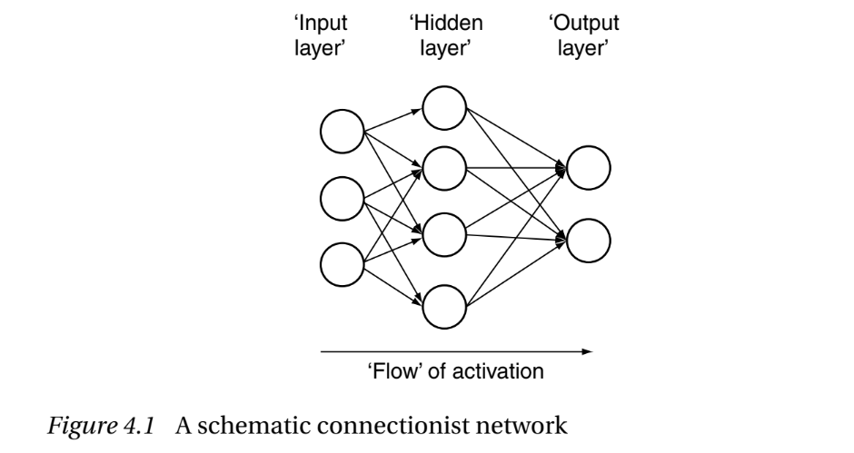
Back Propagation of Error
What neural networks can do well: complex and messy categorization tasks (character recognition, facial recognition).
Modelled after a principle of Differential weighting: your amygdala has very strong connections sending output to the neocortex. But the neocortex has relatively weak connections back to the amygdala.
There are “hidden layers” of connections within these neural networks that modify the signal sent between input and output.
Backpropagation of Error: Hidden layers make the question of training a neural network more complex. The most common method is backpropagation of error.
Initially, weights are assigned randomly within the network. Given the network has data to scan, it estimates the degree of error.
It then adjusts the weights of connections in the most efficient way that generates the biggest reduction in error.
These weights are adjusted based upon a correct target value assigned to the network by the researchers
This process is then repeated, so the network “learns” to recognise certain inputs. Should a network incur damage to any of its nodes, the pattern of activation within the system follows Graceful Degradation: The system adjusts the connection weights in a stepwise fashion towards the point of lowest error to compensate for the activity of the missing nodes.

Slide 26
Supervised Learning
This is entire process of training neural networks involves Supervised learning. However, this can never produce strong AI, only ever weak AI. Because it requires that someone knows what that data set is to begin with, and to feed that data set to the network so that it can read the inputs and determine the weighting of connections!
Proposed solution- Plasticity: one way of getting around this problem is to change not just the weights, but the functions happening within the nodes themselves. It turns out, our brain does this too!
However, this leads to new challenges:
these neural networks leave out a lot of what neurons are capable of
They lack a comprehensive answer to reading language (which GOFAI attempted to do by proposing the solution of symbol manipulation as a means of deriving understanding)

Slide 27
Chapter 5: Criticisms of Connectionism- Compositionality of Language
Our thinking has Compositionality: you can build up complex thoughts by adding together simpler thoughts, in just the same way that words can be put together to form sentences
This is very easily explained within Computational Functionalism: cognition is essentially language-like and determined by the rule-governed manipulation of interpretable strings of symbols.
Fodor and Pylyshyn: argument is the claim that, whilst GOFAI systems can process these representations in a way that is sensitive to their composite structure, connectionist systems cannot.
Two features of thoughts that seem to result directly from their composite structure are what Fodor and Pylyshyn call productivity and systematicity.
Productivity of thought: there are infinitely many molecular sentences that can be composed from a language with only a finite set of atomic words
Systematicity: the ability to produce or understand some sentences is systematically related to the ability to produce or understand others.

Slide 28
Chapter 5: Productivity and Systematicity
GOFAI systems are very good at displaying productivity and systematicity:
On the one hand, this is because their representations are strings of symbols and can thus be combined, split, copied and moved in just the way required.
Moreover, the rules they follow – their algorithms – can be set up such that they are very good at processing molecules in a way that is sensitive to their atomic structure.
GOFAI can therefore offer an explanation of why it is that human thought displays productivity and systematicity; we are such computers and our programs are set up in just that way.
But, Fodor and Pylyshyn argue, the same is not true of connectionist systems because, in effect, their representations do not have this composite structure.
Instead, connectionist networks work off of representations as distributed patterns of activation, where a unique pattern of activity across the set of units that makes up a ‘layer’ in the network.

Slide 29
Chapter 5: Reasons for Preferring Connectionism
1. The speed of cognitive processes in relation to neural speeds requires parallelism (the ‘hundred-step’ argument).
2. GOFAI systems are not naturally good at pattern completion, graceful degradation, fault tolerance etc., whereas connectionist models are.
3. Brains are physically structured more like connectionist models than computers or Turing Machines.
4. Though ‘rules’ might describe cognition and its results, it is not necessary that cognitive systems explicitly encode those rules.
This is in part what makes Connectionism a more biologically plausible than Computational Functionalism: in modelling it’s account of cognition after how our brains work (as opposed to how language works), connectionism is closer to realizing Strong AI despite its shortcomings

Slide 30
Closing
Best of luck on your Midterm!
For studying over the weekend, work on filling out the details using these terms as practice. Supplement your answers with more content from class, or even the readings!
Next Tutorial: November 7th
Tutorial Essay Workshop, writing tips and review of the essay topics

