Slide 1
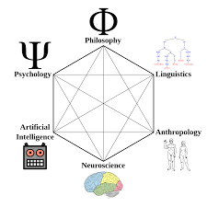

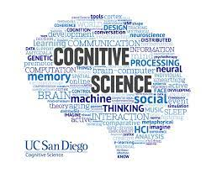
COG 250 Tutorial 2
TA: Konstantinos Xanthios
Oct. 3, 2025
TUT0102, TUT0202, TUT0302
RW142

Slide 2
Outline
Lecture Review:
Computational Functionalism
Connectionism
Discussion Questions

Slide 3
First Generation Cognitive Science: Computational Functionalism
Computational Functionalism: Encompasses the computational theory of mind, or the view that cognition is computation. Functionalism takes inspiration from Linguistics, where cognition follows a rule-like structure, making it fundamentally language-like
Within the context of this course, computational functionalism encompasses Good-Old Fashioned Artificial Intelligence (GOFAI).
Functionalism was a movement away from behaviourism, which unsuccessfully tried to study cognition solely based on observable behaviour conditioned from associations between stimulus and response.
The failure to properly consider the role of mental states lead to the proposal that what is important to study cognition is the function of the cognitive processing, as opposed to only the observable behaviours.
These developments lead to the study of computers as symbol-crunching machines: These are considered to be interpretive, automatic formal Systems as a means of explaining cognition.
We will touch on GOFAI very briefly today, leading up to the problems with computational functionalism and moving onto connectionism

Slide 4
Chapter 3-Searle: Chinese Room Argument
The question now becomes: even though John passed the Turing test, is he capable of actually understanding Chinese?
Searle: The answer to this is no- John is simply manipulating the symbols by following what the rules say about their shapes.
In so doing, John is only doing what a computer does. The rule book is just the program, and by following it, John is executing an algorithm. So, if all of that rule-governed symbol-manipulation is insufficient for understanding, then computers can never understand anything, because that’s all they’ve got.
Thus, computers can’t have minds (because mentality requires understanding the meaning of symbols) and strong AI is false.

Slide 5
GOFAI: Computational Theory of Mind
Functionalism centred on viewing the mind as a Computer: An interpreted automatic formal system, which involves three aspects central to GOFAI (Haugeland). This is heavily inspired by the Linguistic theorist Chomsky, outlining cognition as logically following the rules of language structure (syntax):
Symbol manipulation: Formal systems can manipulate symbols in a way that is governed by syntactic rules.
From this we can get multiple realizability:
  by making the system realizable across many physical media, as long as the symbols are manipulated according to those same sets of rules.
  This means that the same states can be realized in different processes- humans and machines may experience the same states (i.e. language and logic) in spite of different physical components (meat vs. circuitry)
Digitality: It has a set of positive and reliable techniques for reading and writing symbols within the system
Finite playability: A finite system is capable of following rules in a mindless, mechanical manner.
Automaticity: A formal system is considered to be automatic if its complex computational processes can be broken down into primitive algorithms composed of primitive operations and primitive rules, such that it can run and follow those rules on its own.
This is responsible for the self-containedness of formal systems, and in so doing forms the basis of GOFAI and the computational theory of mind

Slide 6
Chapter 3- The Turing Test: Example of GOFAI
Alan Turing: demonstrated that machines can be set up to perform symbol crunching to solve any well defined problem. Did this by reducing the syntax down to a symbol set, for the machine to churn out a solution following a set of rules (much like a formal system)
Turing’s developments eventually gave way to the idea of an “imitation game” for trying to find an instance of human intelligence. This was later referred to as the “Turing Test”:
The set-up is this: Two systems have a conversation with one another- one is a human, and the other a computer.
A judge/interrogator attempts to work out, solely by means of written questions and answers, which of two other conversants is a human and which is a computer/machine.
If the judge were to mistake the machine’s performance to be that of a human’s, then the machine were said to have passed the test.

Slide 7
Chapter 3- Searle, Chinese Room Argument
Using Turing’s set-up, Searle positioned a thought experiment that proved to be a powerful counter-argument against the prevailing view of computational functionalism. This was the Chinese Room Argument:
“Imagine a man – let’s call him John –who knows no Chinese, but is locked in a room in which there are a number of boxes of Chinese symbols. John’s only contact with the outside world is via a mail slot through which slips of paper can be passed. In the room there is also a scratch-pad for rough work, and a large book, in English, which contains a great number of rules that tell John how to match certain sequences of Chinese characters with other sequences of Chinese characters. The rule- book says things like ‘If such-and-such characters come in through the mail slot, wait a short while and then push so-and-so characters out of the mail slot.’ John might not even know that the symbols are Chinese, but this doesn’t matter, because he can work by simply matching the shape of the characters in the inbox to the shape of those depicted in the rule book.
Unbeknownst to John, there are native Chinese speakers outside of the room, and they are the ones passing the strings of symbols into the room and retrieving the strings of symbols that John sends out. They call these symbol strings ‘questions’ and ‘answers’. Finally, suppose that the rules are so sophisticated, and that John is so good at following them, that the native Chinese speakers are not able to distinguish the ‘answers’ they get from John-in-the-room from those that would be given by another native Chinese speaker. John-in-the-room passes the Turing Test in Chinese”

Slide 8
Quick Discussion: Functionalism and Strong AI
Recall from Lecture and Readings: :)
Strong AI: The initiative of creating a bona-fide instance of human cognition (an artificial mind)
Weak AI: The initiative of creating something that imitates human cognition (a machine that performs a certain cognitive function)
Syntax: Rules of logical structure
Semantics: The meaning derived from the propositions themselves
Quick Discussion: Searle’s argument seems pretty devastating for functionalism. However, when considering the possibility for Strong AI, do you see any problems with this argument, especially concerning the difference between syntax and semantics?

Slide 9
Response to the Chinese Room: Connectionism and Second Generation Cog Sci
Andy Clark: Searle is looking at a too coarse-grained view of what computation can be. For functionalism, the overwhelming focus placed on symbol manipulation is only a problem if their consideration of mental states is placed after the logical processing takes place
When this happens, meaning is essentially stripped away from the cognitive system. It is not adequately taken into account how the mental states (beliefs, desires and intentions) came to be- they are only taken to be a product of symbol manipulation.
Connectionism and Neural Networks: Perhaps meaning can be preserved by looking at overall patterns of activation happening within a cognitive system, as opposed to a logical formal system
An alternative to GOFAI: cognition is not computation involving an interpretive, automatic formal system. The idea was to build artificial brains, called neural networks
Connectionism is a brain model of the mind

Slide 10
Parallel Distributed Processing
Parallel Distributed Processing
Neural networks involve a system of parallel processors, with the potential to relay information between one another. This is done to model patterns of overall activation happening within a cognitive system
Module: a small specialist system that takes a limited number of inputs and produce outputs algorithmically.
These networks were modelled after how neurons fire and wire together: 3 components
1) firing rate: how quickly they fire
2) inhibition or excitation: the frequency by which they begin to fire
3) weight of connection: how much emphasis is placed on the signal of that node

Slide 11
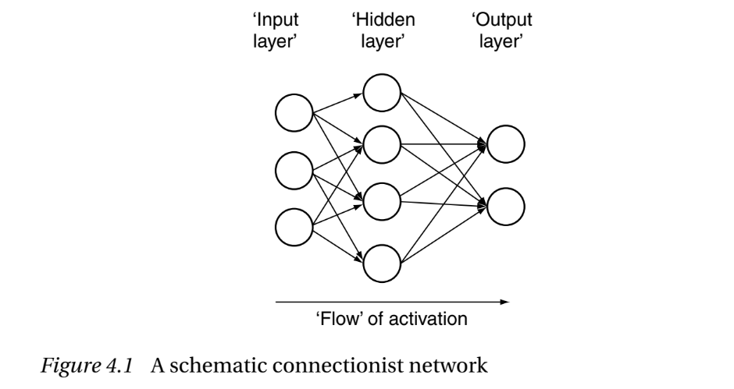
Back Propagation of Error
What neural networks can do well: complex and messy categorization tasks (character recognition, facial recognition).
Modelled after a principle of Differential weighting: your amygdala has very strong connections sending output to the neocortex. But the neocortex has relatively weak connections back to the amygdala.
There are “hidden layers” of connections within these neural networks that modify the signal sent between input and output.
Backpropagation of Error: Hidden layers make the question of training a neural network more complex. The most common method is backpropagation of error.
Initially, weights are assigned randomly within the network. Given the network has data to scan, it estimates the degree of error.
It then adjusts the weights of connections in the most efficient way that generates the biggest reduction in error.
These weights are adjusted based upon a correct target value assigned to the network by the researchers
This process is then repeated, so the network “learns” to recognise certain inputs. Should a network incur damage to any of its nodes, the pattern of activation within the system follows Graceful Degradation: The system adjusts the connection weights in a stepwise fashion towards the point of lowest error to compensate for the activity of the missing nodes.

Slide 12
Discussion Question
Today we’ve looked at 2 accounts of cognition: Computational Functionalism and Connectionism
Which of these do you think is a stronger account of how our minds work?
  Computational Functionalism: Cognition is language-like, occurring by means of symbol manipulation according to a logical set of rules
  Connectionism: Cognition is brain-like, occurring by means of overall patterns of activation sent amongst nodes within a network
With respect to how they understand cognition, do you see any criticisms with any of these frameworks?
Do any of these frameworks bring us closer to realizing strong AI (i.e. creating an artificial mind)?

Slide 13
Supervised Learning
This is entire process of training neural networks involves Supervised learning. However, this can never produce strong AI, only ever weak AI. Because it requires that someone knows what that data set is to begin with, and to feed that data set to the network so that it can read the inputs and determine the weighting of connections!
Proposed solution- Plasticity: one way of getting around this problem is to change not just the weights, but the functions happening within the nodes themselves. It turns out, our brain does this too!
However, this leads to new challenges:
these neural networks leave out a lot of what neurons are capable of
They lack a comprehensive answer to reading language (which GOFAI attempted to do by proposing the solution of symbol manipulation as a means of deriving understanding)

Slide 14
Chapter 5: Criticisms of Connectionism- Compositionality of Language
Our thinking has Compositionality: you can build up complex thoughts by adding together simpler thoughts, in just the same way that words can be put together to form sentences
This is very easily explained within Computational Functionalism: cognition is essentially language-like and determined by the rule-governed manipulation of interpretable strings of symbols.
Fodor and Pylyshyn: argument is the claim that, whilst GOFAI systems can process these representations in a way that is sensitive to their composite structure, connectionist systems cannot.
Two features of thoughts that seem to result directly from their composite structure are what Fodor and Pylyshyn call productivity and systematicity.
Productivity of thought: there are infinitely many molecular sentences that can be composed from a language with only a finite set of atomic words
Systematicity: the ability to produce or understand some sentences is systematically related to the ability to produce or understand others.

Slide 15
Chapter 5: Productivity and Systematicity
GOFAI systems are very good at displaying productivity and systematicity:
On the one hand, this is because their representations are strings of symbols and can thus be combined, split, copied and moved in just the way required.
Moreover, the rules they follow – their algorithms – can be set up such that they are very good at processing molecules in a way that is sensitive to their atomic structure.
GOFAI can therefore offer an explanation of why it is that human thought displays productivity and systematicity; we are such computers and our programs are set up in just that way.
But, Fodor and Pylyshyn argue, the same is not true of connectionist systems because, in effect, their representations do not have this composite structure.
Instead, connectionist networks work off of representations as distributed patterns of activation, where a unique pattern of activity across the set of units that makes up a ‘layer’ in the network.

Slide 16
Chapter 5: Reasons for Preferring Connectionism
1. The speed of cognitive processes in relation to neural speeds requires parallelism (the ‘hundred-step’ argument).
2. GOFAI systems are not naturally good at pattern completion, graceful degradation, fault tolerance etc., whereas connectionist models are.
3. Brains are physically structured more like connectionist models than computers or Turing Machines.
4. Though ‘rules’ might describe cognition and its results, it is not necessary that cognitive systems explicitly encode those rules.
This is in part what makes Connectionism a more biologically plausible than Computational Functionalism: in modelling it’s account of cognition after how our brains work (as opposed to how language works), connectionism is closer to realizing Strong AI despite its shortcomings

Slide 17
Closing
Next Tutorial:
Oct. 17: Midterm Test Review
  Midterm format, practice questions and more review of content
Test 1 is on Oct. 22
Happy Studying!

