Slide 1
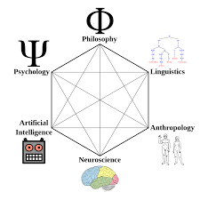


COG 250 Tutorial 1
TA: Konstantinos Xanthios
Sept. 19, 2025
TUT0102, TUT0202, TUT0302
RW142

Slide 2

Roadmap
Introductions
Tests and Assignments
Study Methods and Note Taking Approaches
Lecture Review
Discussion Question

Slide 3
Housekeeping
Tutorial Slides are posted under Modules—Konstantinos. They are linked in my Bio!
Revised Tutorial Schedule:
Fall 2025: Winter 2026:
September 19 - January 23
October 3rd - February 6
October 17 - February 27
November 7 - March 13
November 21 - March 27
Mark has posted the recording of Lecture 3 on Quercus

Slide 4

About Me
PhD Candidate: Developmental Psychology and Education Uoft (OISE)
Graduated from OISE (MEd); BSc. Psychology and English Literature at UofT
Advisor: Dr. Michel Ferrari- Wisdom and Identity Lab
Research Interests: Science of Wisdom
Embodied cognitive science: investigate clinical wisdom of graduate students, and how narratives allows us to make meaning of our experiences
How experiences of moral injury affect perceptions of meaning in life for veterans and first responders
Contact: gus.xanthios@mail.utoronto.ca
Tutorial Sections and Location: TUT0102, TUT0202, TUT0302, Ramsey Wright Laboratory, Room 142
Office hours: Tuesdays, 2:00-3:00pm https://utoronto.zoom.us/j/7971534931

Slide 5

Introductions: Getting to Know You
Names
Current Program and Year of Study
What inspired you to take this course?

Slide 6
Midterm and Exam Format
Midterm 1: Oct. 22- 10%
You will be provided with a list of 10 concepts. You are responsible for choosing 6 of these and providing:
  Definition: Briefly define the concept in question
  Relevance: Explanation of its Relevance to the course
  Criticism of the concept (this could be taken from Mark’s lectures).
    OR: You could use the concept in question to criticize something else.
  Novel Connection: Connecting the chosen concept to another idea in the course. For example, if the concept is “Dualism”, you could choose to talk about it’s relation to one of the approaches to Cognitive Science discussed in class (Computational Functionalism, Connectionism, etc.)
Aim to provide this information in approximately 200 words for each concept, although you can use as much space as is necessary.
Midterm 2: Feb. 11- 15%
Section 1: Same as Midterm 1, except you will choose to answer 4 concepts out of a possible 9.
Section 2: Long Essay Answer- Section 2 is a longer argumentative essay. Students will choose 1 out of 3 questions. 1000 words per answer. To successfully complete section 2, students will:
  State a clear and relevant thesis
  Critically review lecture material and reading material
  Make an argument, not a summary: do this by integrating reviewed material into their essay in a novel way, such that you can effectively defend the thesis
Final Exam: will be same format as midterm 2. I will also do more in-depth explanations of tests assignments later tutorials, including tips for essay writing.
1st Essay- Nov.26: 2000 words- Prompts for Essay 1 are now posted on Quercus
2nd Essay Proposal- due Feb. 16
Essay 2- due April 1: 3000 words

Slide 7
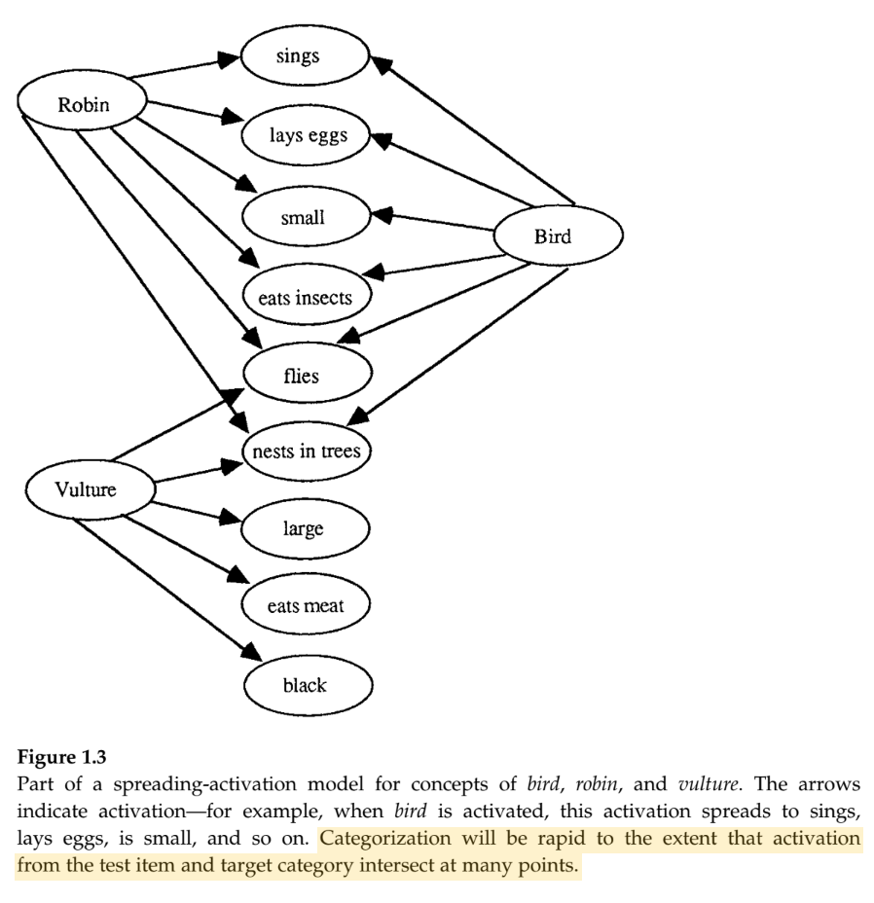
Study Strategies: Novel Connections
Tests and Essay Assignments will evaluate your ability to make connections between the concepts and the arguments in this course.
Making connections enhances your ability to generate new arguments and allows you to master the content faster.
Example: Spreading of Activation Model for Concepts (Smith, 1995)
Used as potential explanation for speed of categorization
“Spreading of activation”: Language for patterns that occur when describing changes in hemispheric activation in our brains
Also used in artificial intelligence approaches to train neural networks

Slide 8
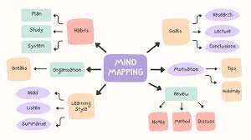
How to Make Connections?
You can train your ability to make connections by doing the following:
Collaborating with Other Students: Form study groups, get to know one another and practice taking each other's perspectives
Recognise Before Recall: Try testing your ability to recall the argument of the course, using the concepts presented in lecture.
Synthesise: Explore how different ideas combine together- can this make your argument stronger?
Diagram: Visualise the relationships between concepts using a mind-map

Slide 9
My Role as a TA, Tutorial Structure: What to expect going forward
What I can do:
Explain test and assignment formatting and structure
Give advice on what’s expected
Discuss COG 250 content
What I can’t do:
Be consulted for your answers
Provide terms that will be on the test
Tutorial Structure- First 30 minutes:
Info from me about assignments/tests
Lecture Review- important course concepts and compelling connections
Last 20 minutes:
Discussion questions/activities
Opportunity for you to ask me questions about the content, tests, assignments, or other aspects of the course.

Slide 10
Lecture 1 Review: How to do Cognitive Science
There are several different disciplines which attempt to explain the mind at different levels of analysis. The role of cognitive science is to determine the relationship between these different levels and disciplines that study the mind:
Level: Culture and distributed cognition—Discipline: Anthropology
Level: Language and language structure or processing—Discipline: Linguistics
Level: Behavior–Discipline: Psychology
Level: Information processing and machine simulations—Discipline: Computer Science
Level: Brain-imaging and neurophysiology—Discipline: Neuroscience
The role of Philosophy: It makes a conceptual unity of these disciplines and tries to provide bridging constructs/common conceptual terms between them.
Cognitive Science is thus a discipline that studies the mind in terms of the interaction between all these other disciplines. This makes the role of the cognitive scientist much like the philosopher in terms of their eye for cross-discipline interactions.
Synthetic Philosophy: aims at developing new frameworks. “Synthetic philosophy” is a style of philosophy that brings together insights from the special sciences in order to develop new theoretical frameworks for thinking about those special sciences and topics in philosophy (Schliesser 2019).
In so doing, cognitive science aims to achieve an interdisciplinary study of the mind, in an attempt to discover how these levels of examining cognition relate to one another and thus provide a fuller, more synthesized account of what cognition is.

Slide 11
Lecture 1: Problems posed by Cognitive Science
The problem of Equivocation: Equivocation involves an inherent ambiguity in any explanation. It occurs when we have two different systems that are using the same language, but in entirely different ways.
Consider the term: “Information”
  in genetics, information is “encoded”- how those particles in gene are internalized
  Physics- the term information pertains to changes in the entropy of the system
As we will see, the term “Computation” is also subject to equivocation in different fields.
The Siloing problem of the specialized sciences
  Siloing: a special science pays only attention to what an individual system is doing, instead of paying attention to the actions of its neighboring sciences
In both cases, an interdisciplinary approach that synthesizes disciplines together is well-equipped to provide the conceptual clarity necessary for examining cognition across different levels of analysis.

Slide 12
Lecture 2 Review: What is a Mind?
Scientific Revolution: period of rapid mathematical and technological advancement, leading to discoveries of inertial motion: objects in the universe aren’t moving with a sense of purpose. Their behaviour follows a series of mathematical laws (as studied by physics).
Rene Descartes: argues that what we need in order to know the world and derive certainty is to make our mind a mathematical, a logical machine.
Material Substances: can be mathematically measured, calculated, predicted and manipulated.
  Primary properties: are actually “real” properties in the world, exist in objects. These mathematical properties are objective properties that exist in the world.
Mental Substances: non-mathematical, subjective and exist in our minds as part of our experience, but not in the world. They were said to be illusory as they only exist as a subject of our experience.
  Encompass secondary properties: “Qualia” and exist as part of our conscious experience
This leads to the proposal of Cartesian Dualism: The mind is constitutive of mental substances, the body of material. This gives rise to the Mind-Body Problem

Slide 13
Lecture 2: Hobbes Proposal and Descartes’ Response
Thomas Hobbes: grapples with these new advancements happening during this time, and proposes the view that cognition is computation.
In Hobbes’ proposal, the mind is tantamount to a material computer, with matter that automatically follows a series of logical manipulations according to a set of rules. For Hobbes, this notion of computation is what it means for a mind to be cognitive.
Hobbes saw this computing machine as a way of explaining how we can engage in our capacities for reason (ratiocenation), as a means of doing science.
Descartes: Responds to Hobbes
If one is doing science, they must be capable of reasoning- which involves acting on purpose to get to the goal of truth as a normative standard and as a way of improving oneself.
One can’t tell is something is true, and move towards it on purpose, unless one knows what that truth means.
Thus, Truth is actually a function of meaning, which has to do with Qualia- aspects of the subjectivity of our conscious experience
These secondary properties can’t be measured mathematically , even though they are crucial to engage in scientific reasoning

Slide 14
Paradox of Mechanical Reasoning, Problem of Original Meaning
Hobbes responds by suggesting intentionality: mental things point to, are directed at, and have content about something other than themselves. This intentionality is part of what makes mental things meaningful.
However, Descartes notes that Hobbes is now equivocating and is making a mistake. The concepts represented with intentionality are understood by Hobbes as purely physical things. Descartes is pointing out two things to Hobbes, which are related:
The Paradox of mechanical reasoning: if a process is operating purely mechanically, then it is not operating on purpose with a goal of getting closer to the truth. It’s not concerned with the meaning and qualia of our experience.
  Therefore, If this process is purely mechanical, then it can’t possibly be reasoning!
At the heart of this is the problem of original meaning: Matter (or material processes), according to Descartes, cannot possibly possess meaning in and of themselves. They can only have derived meaning by being systematically associated with purely mental states that have meaning.
  This is the case because, according to the scientific revolution, mental properties (qualia) only exist subjectively in our mind. Matter (or mechanical processes), by definition, exist objectively

Slide 15
Section 3- The Point: The Project of AI
With Hobbes’ statement that cognition is computation, he proposes the project of artificial intelligence during the advent of the scientific revolution
This proposal of artificial intelligence and the generation of the scientific worldview are deeply interwoven and interdependent.
That’s why the project- or what Haugeland calls “the very idea”- of artificial intelligence has a philosophical depth to it, and is not simply about making machines.

Slide 16
2 Contemporary Perspectives on AI: Walmsley Chapter 1 (Week 2 Reading)
Perspective 1: Newel and Simon: who explicitly regard computers and programs as experiments -
“constructing the machine poses a question to nature; and we listen for the answer by observing the machine in operation” (1976, p.114).
In this case, AI is an empirical science: We often have to rely on observation of what the computer does, much as if we were observing the participant in a conventional psychology experiment. Iterations are made to the program to more accurately capture the behaviour we’re looking for
Perspective 2: André Kukla (1989a) : Argues that AI is not an empirical science, but rather is – like mathematics – an a priori enterprise
Contrasts work in AI with experiments in psychology. Goal in psychology is to come up with a theory about the underlying structure that generates the observed behaviour. But when we run a program on a computer, we already know the underlying structure; it’s the program, and we wrote it!
The relation between a computer’s program and its behaviour is a logical one (akin to the relation between the premises and the conclusion of a deductive argument). So running a program is equivalent to constructing a logical proof.

Slide 17

Discussion Question: Is AI more like Science or Math?
Considering these 2 perspectives, and your own understanding of Artificial Intelligence:
Do you agree with Newel and Simon, or Kukla?
Alternatively, is there another possibility aside from these two perspectives that you feel makes a stronger case?

Slide 18

Thank You!
Happy studying, I hope you found this tutorial helpful!
Talk to each other, form study groups and arrive at a mutual understanding of the course by sharing your perspectives
Next Tutorial: October 3rd
Computational Functionalism and GOFAI

